Slide 1
attitude & knowledge
2017 Market Singapore ANNUAL convention
Stacy Tung

Slide 2


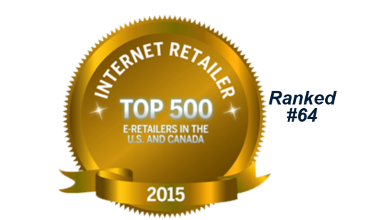


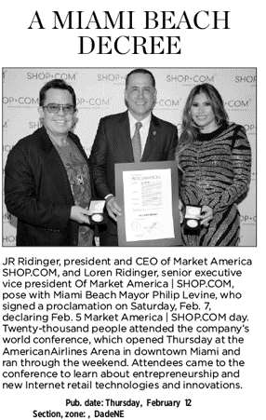
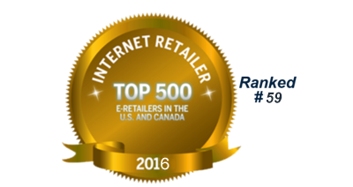

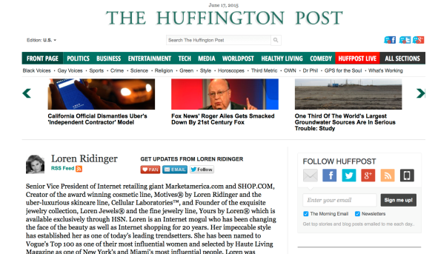
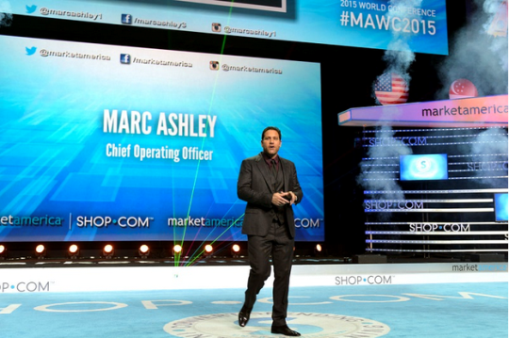
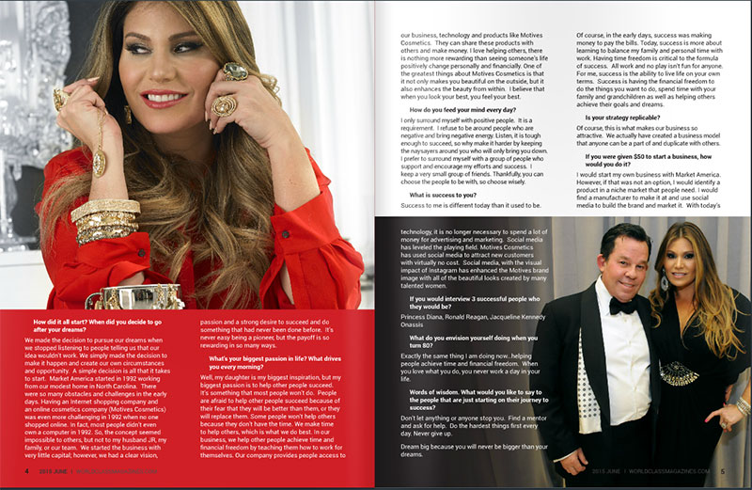

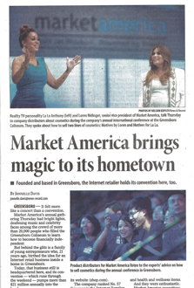
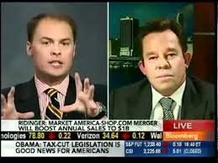
in the news
2013 Torch ]Award Winner Trust • Performance • Integrity BBB of Central NC

Slide 3
WORLDWIDE
COMPANY SALES
ESTIMATED ACCUMULATED RETAIL SALES†:
S$10,009,722,876
+
=
TOTAL ESTIMATED RETAIL
PROFITS EARNED*:
S$2,642,848,329
TOTAL COMMISSIONS
EARNED:
S$2,578,093,334
TOTAL UNFRANCHISE®
OWNER EARNINGS**:
S$5,220,941,663
**AS OF SEPTEMBER 30, 2016 (SINCE THE COMPANY’S INCEPTION) *ESTIMATED RETAIL PROFITS BASED ON SUGGESTED RETAIL PRICE
†ESTIMATED ACCUMULATED RETAIL SALES BASED ON SUGGESTED RETAIL PRICE

Slide 4
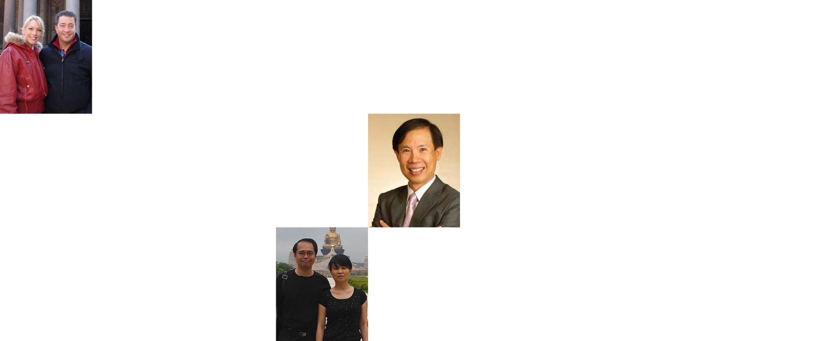
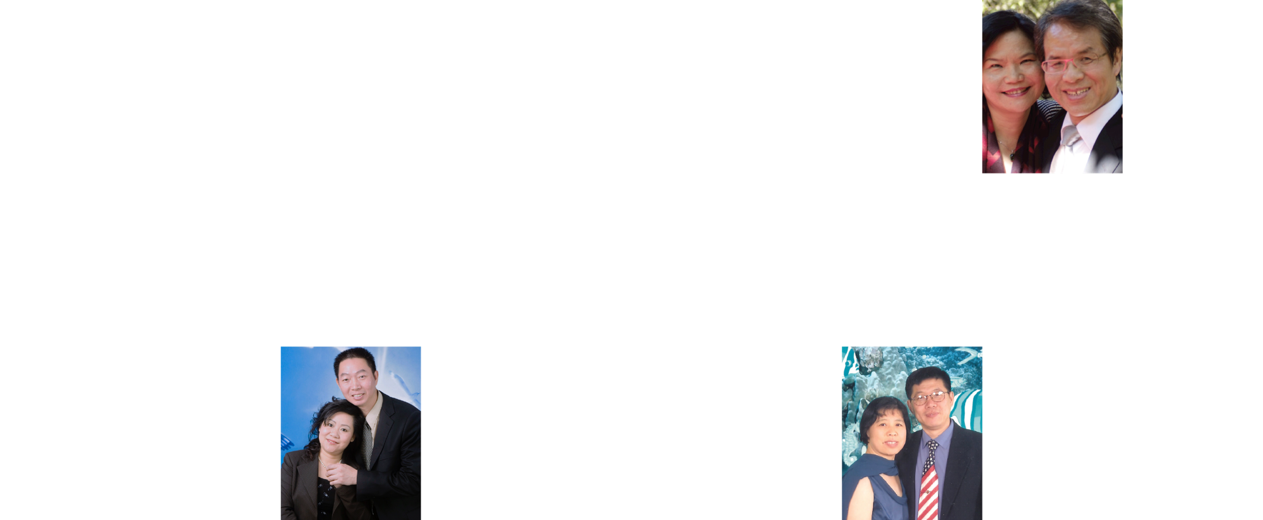
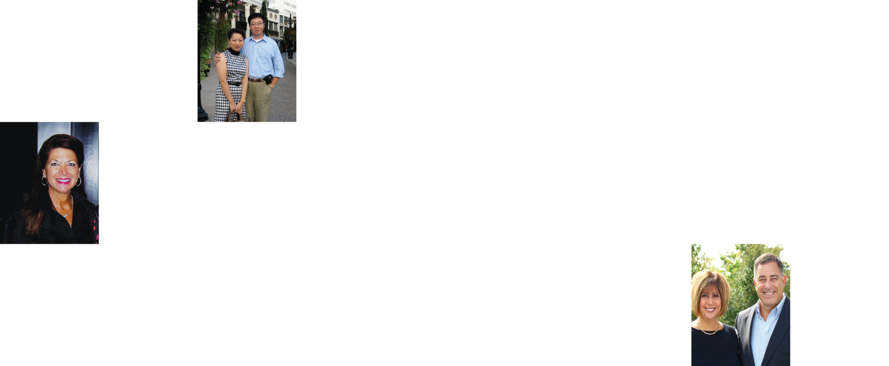
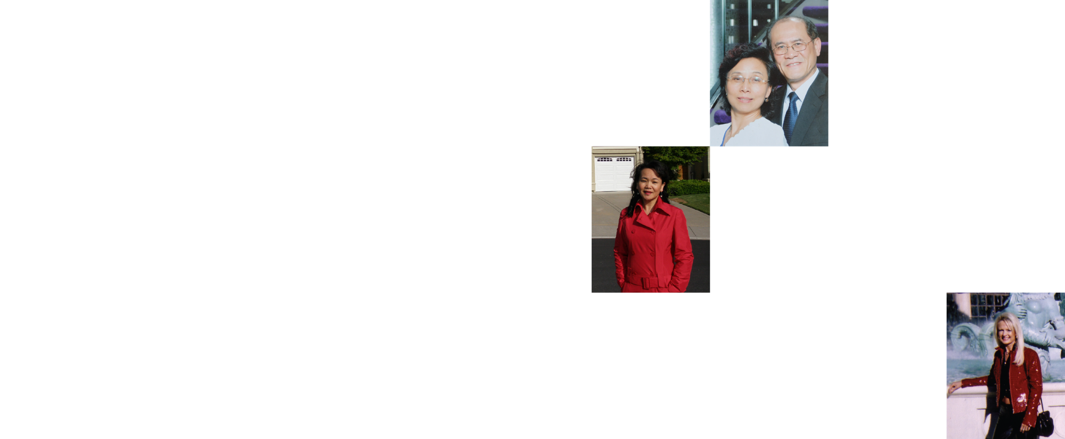
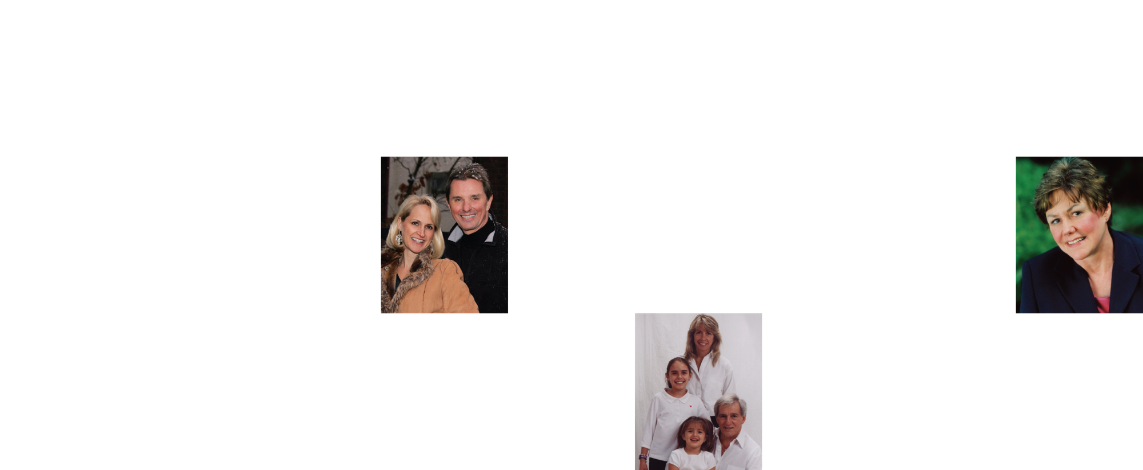
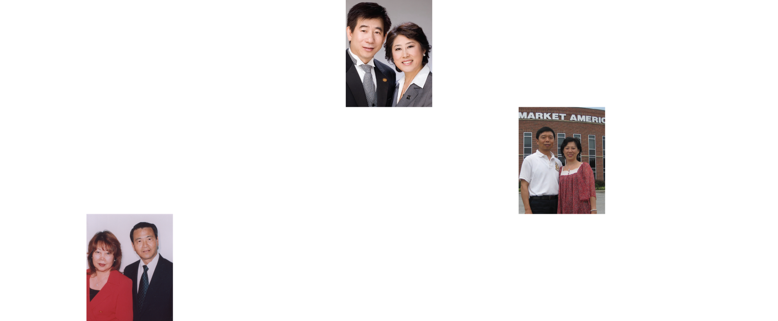
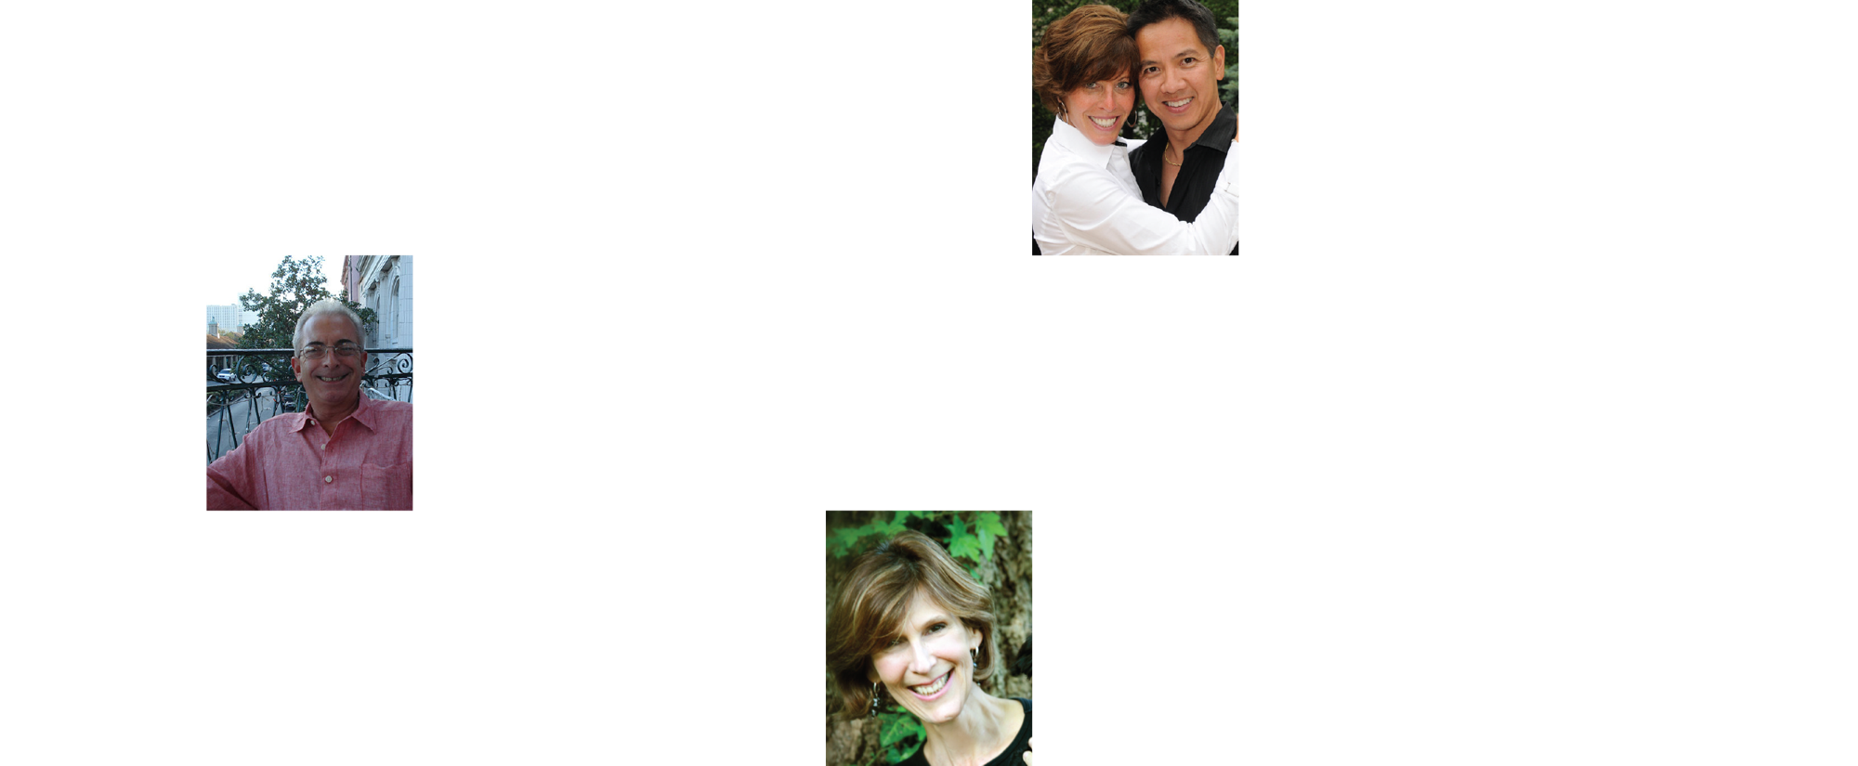
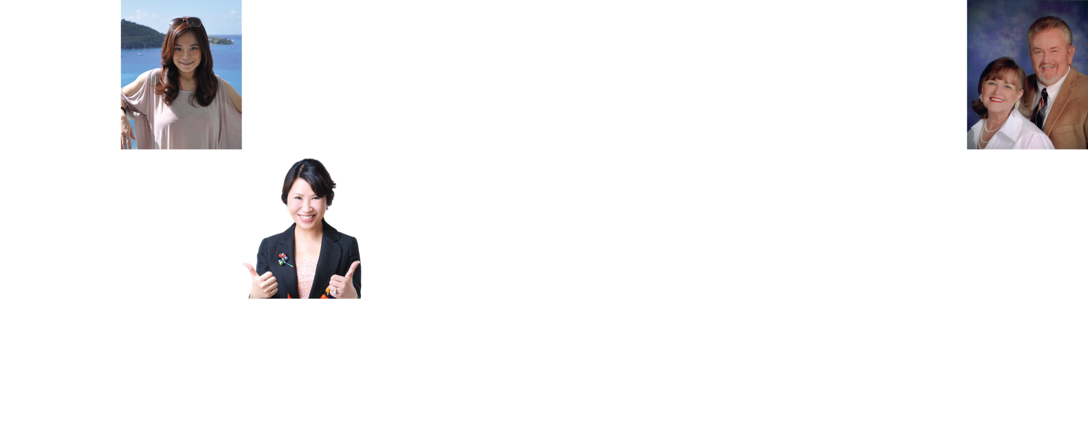
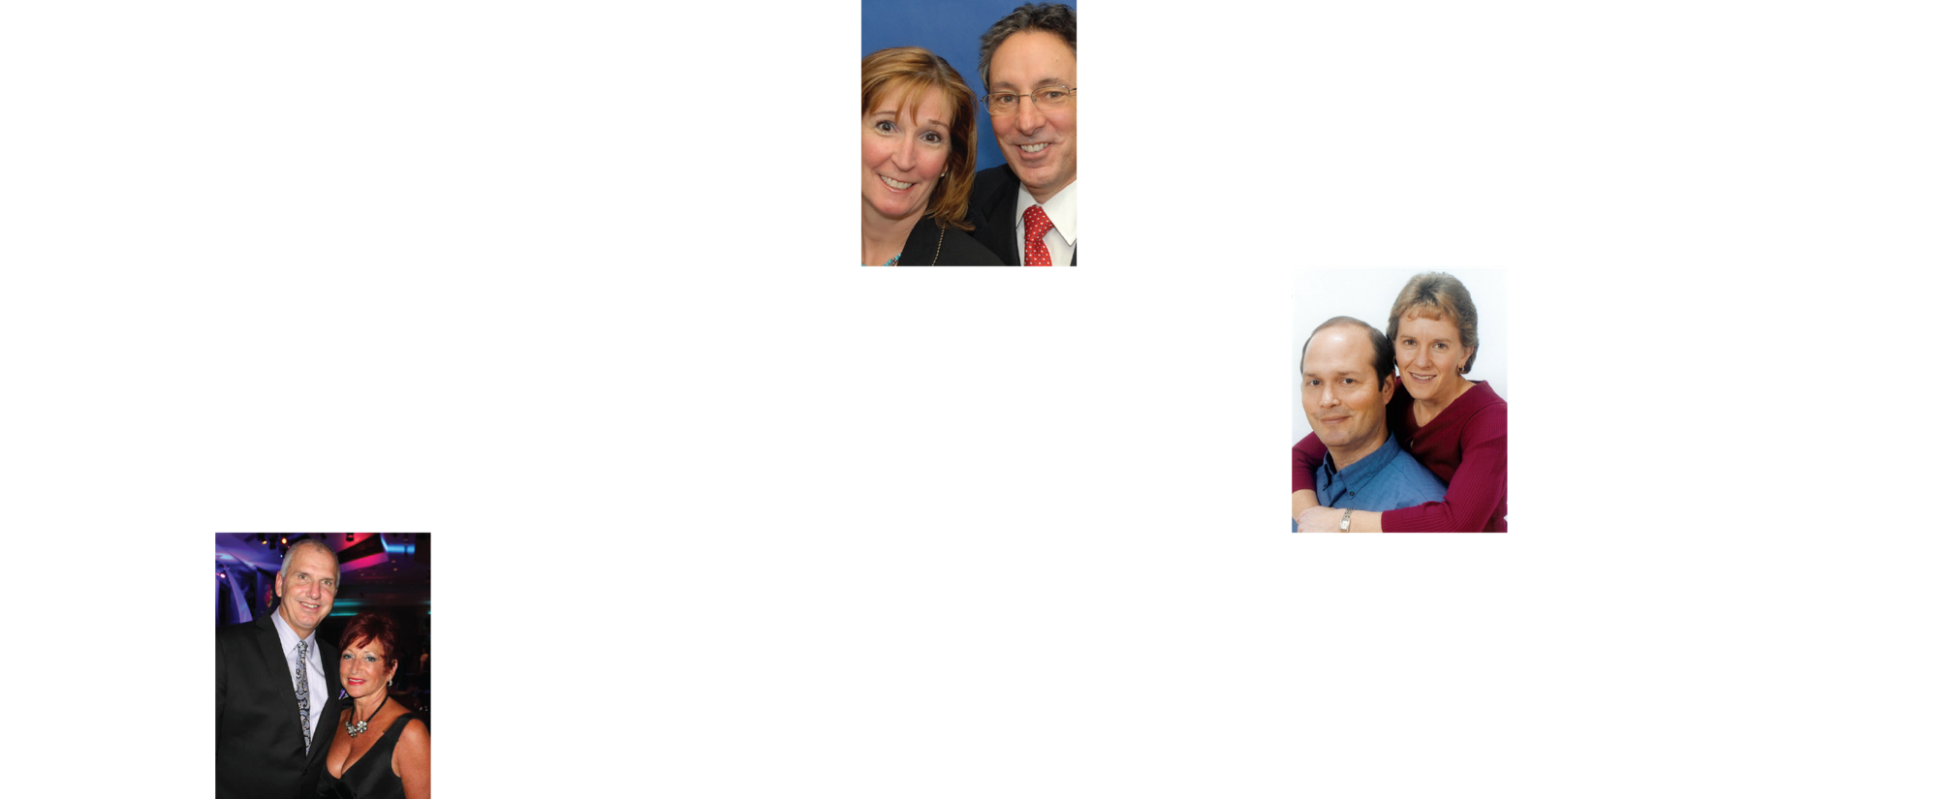
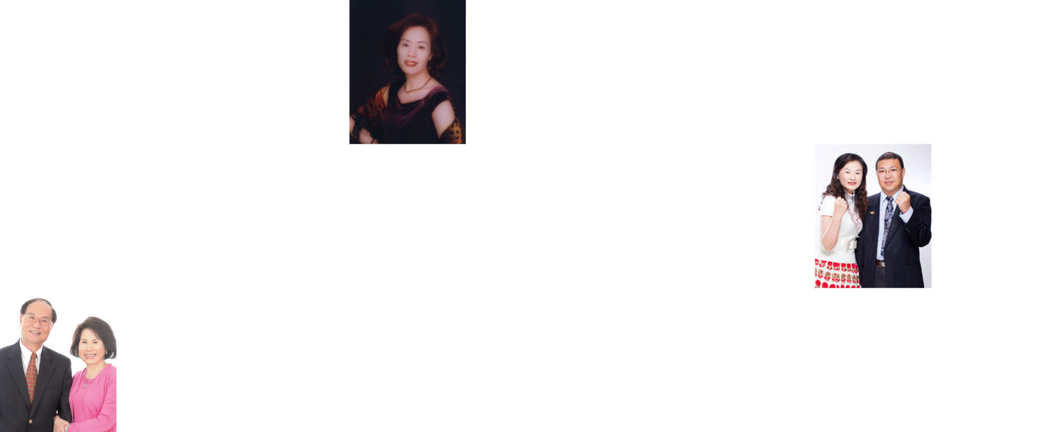
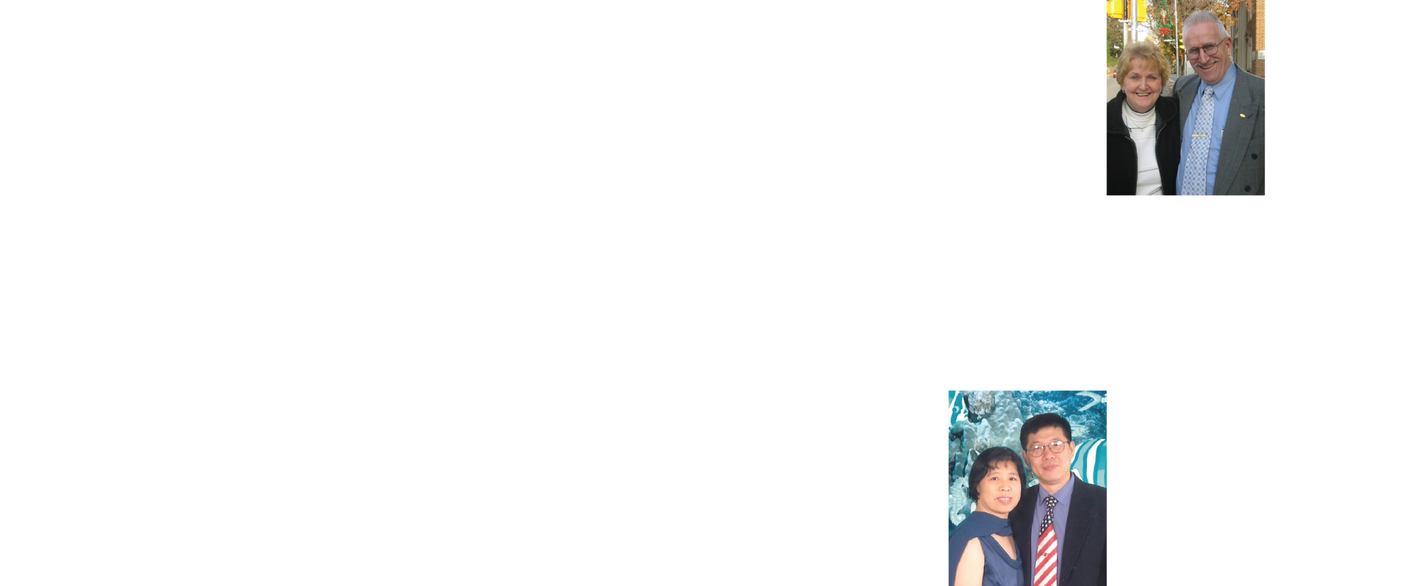
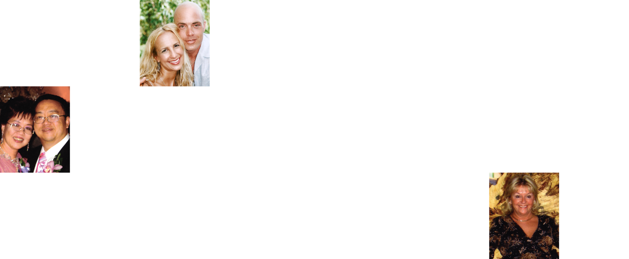
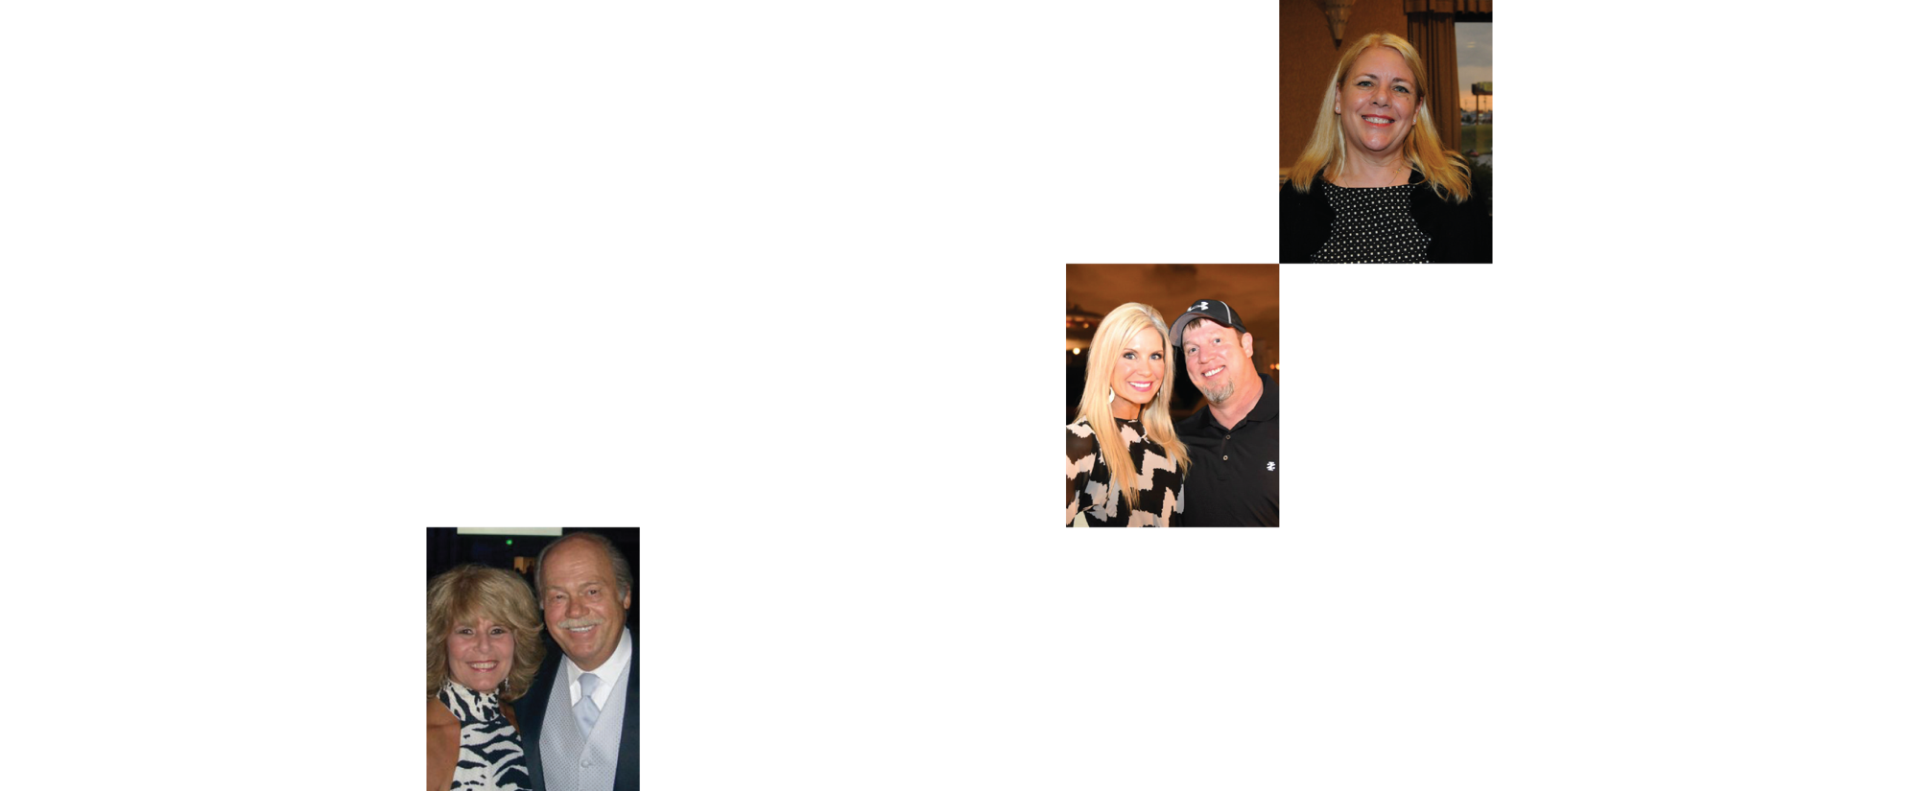
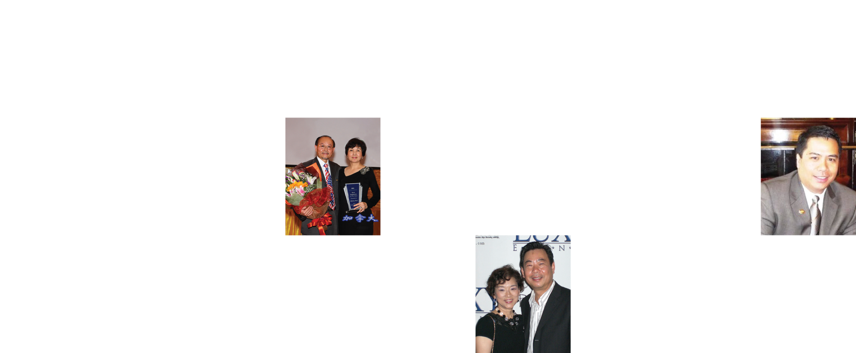
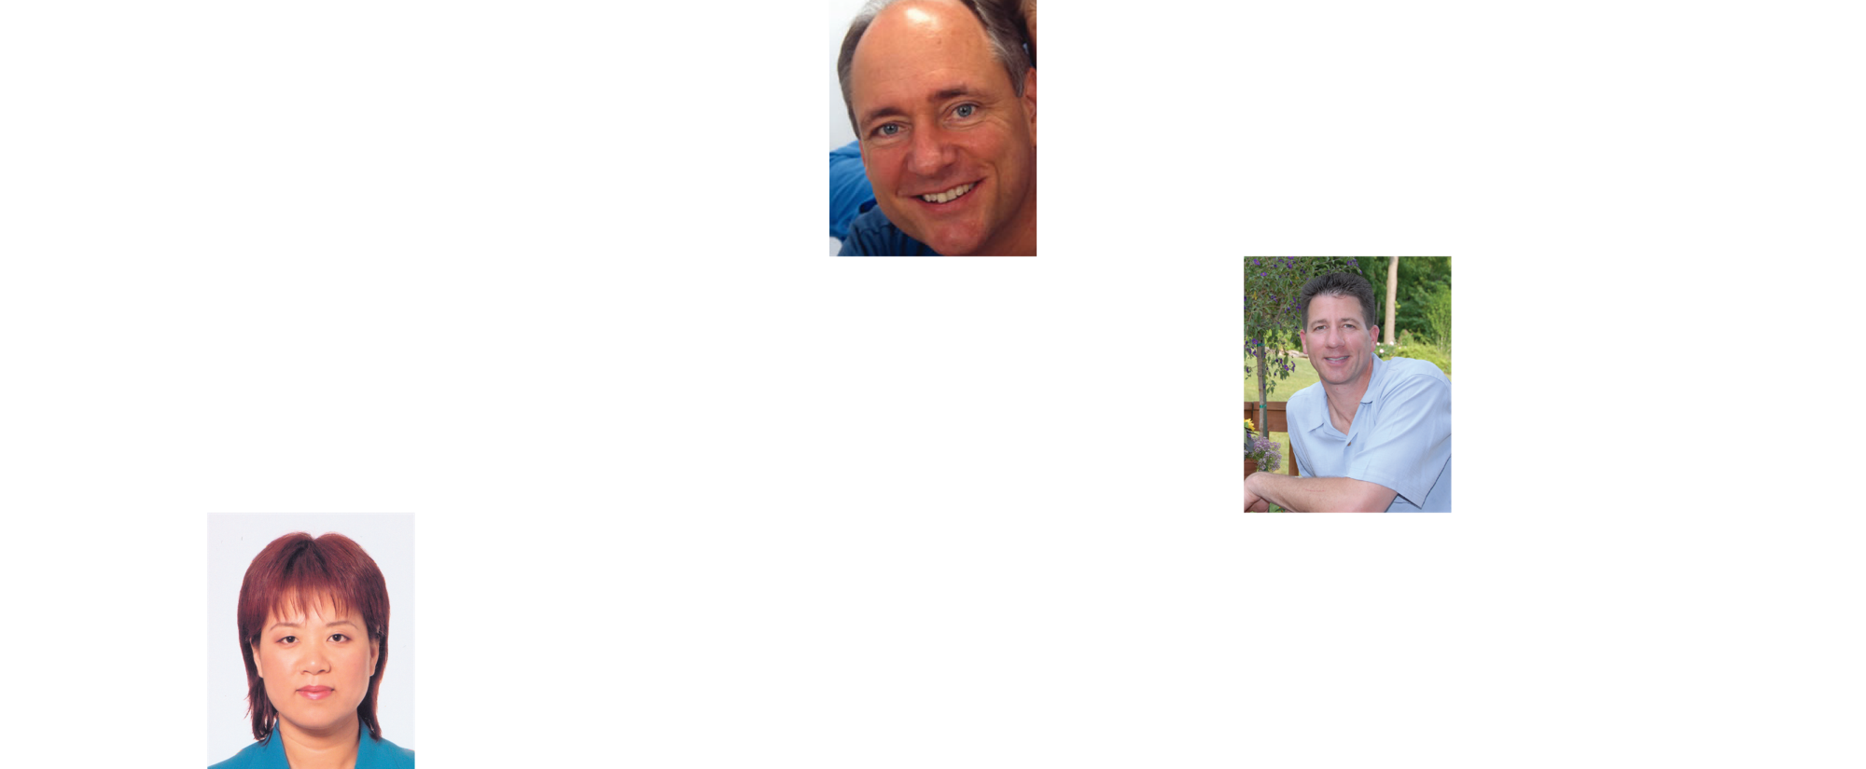
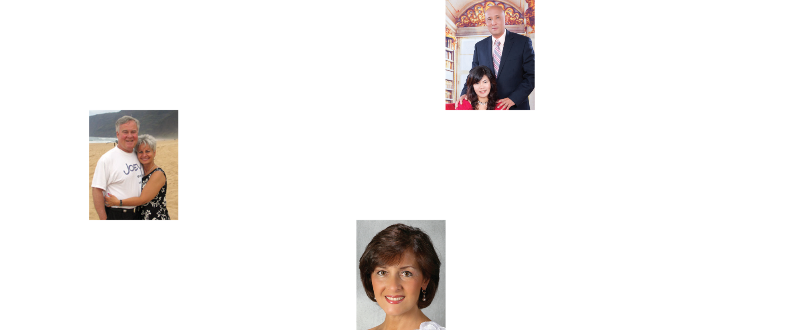
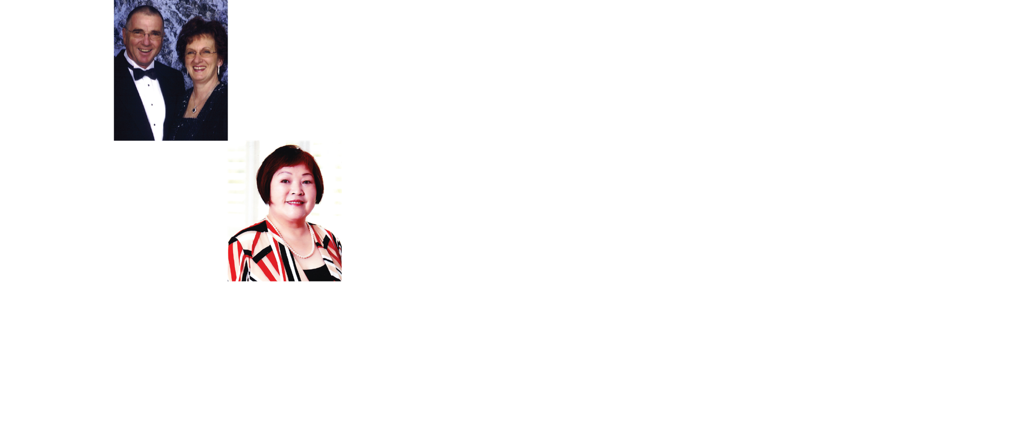
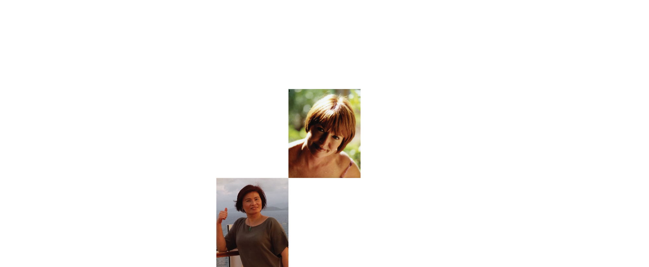
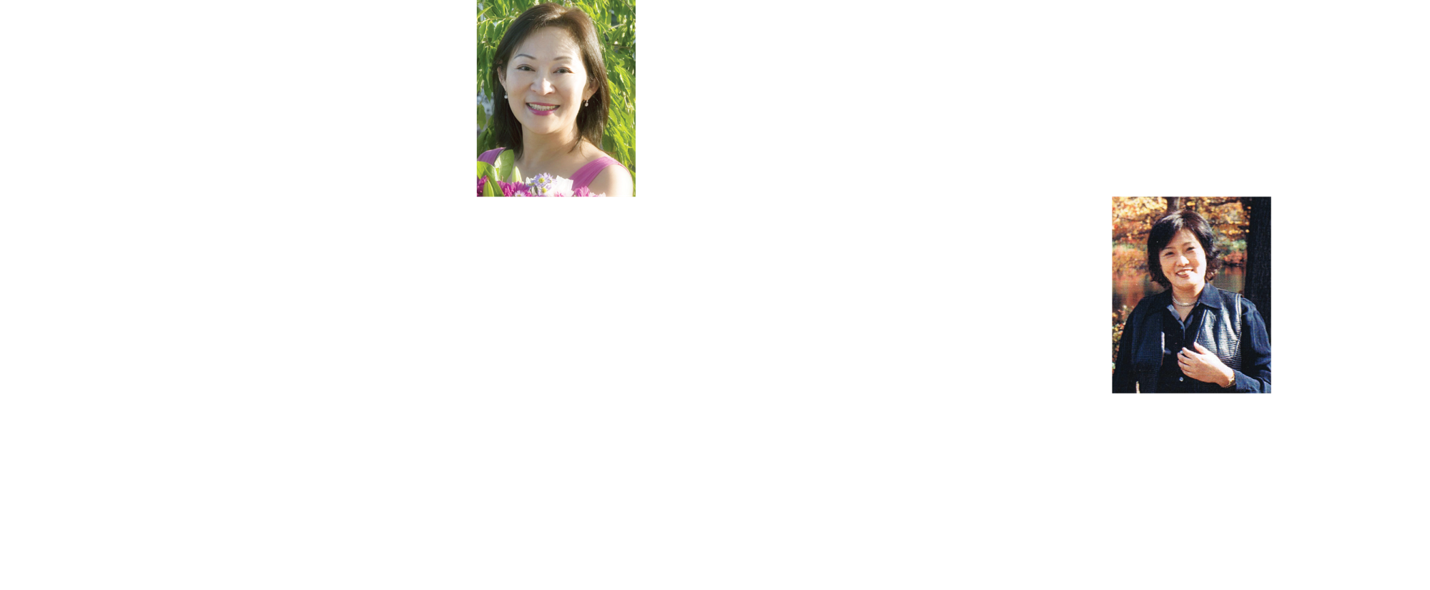
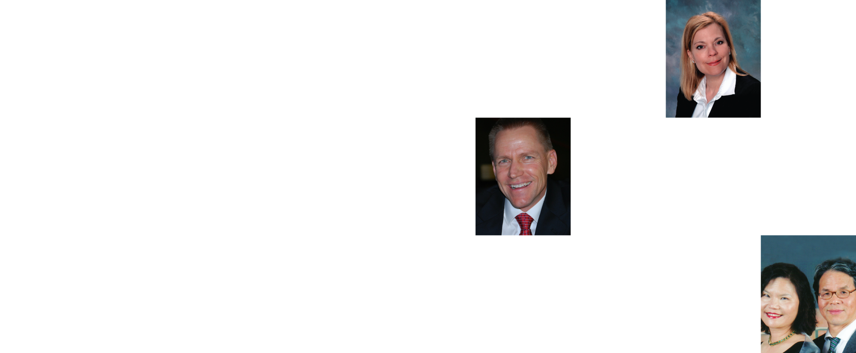
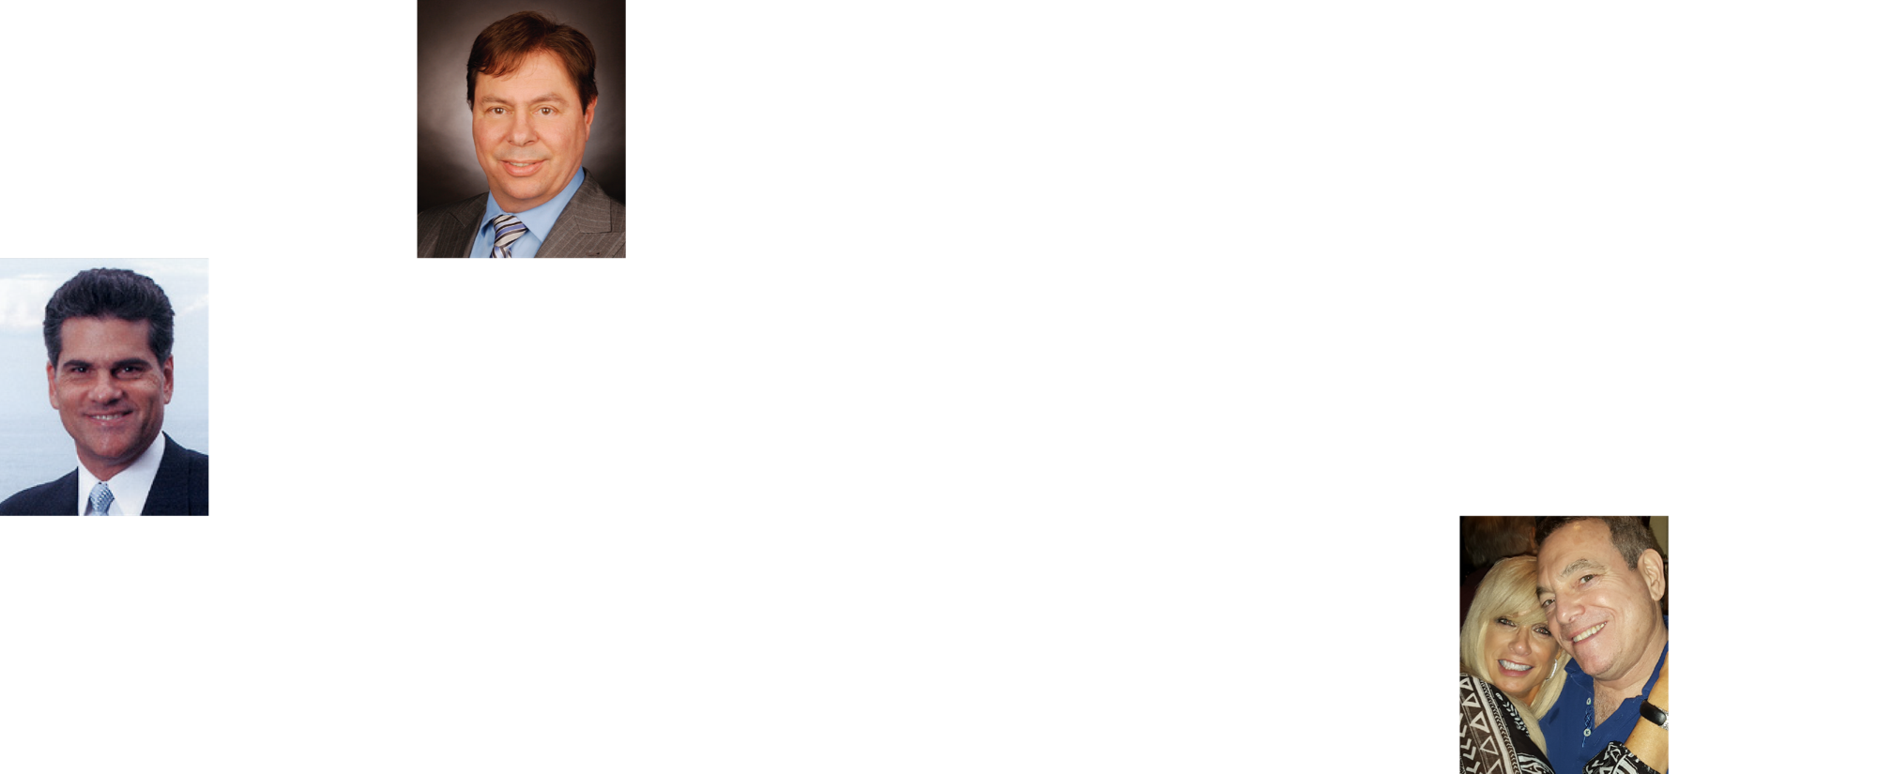
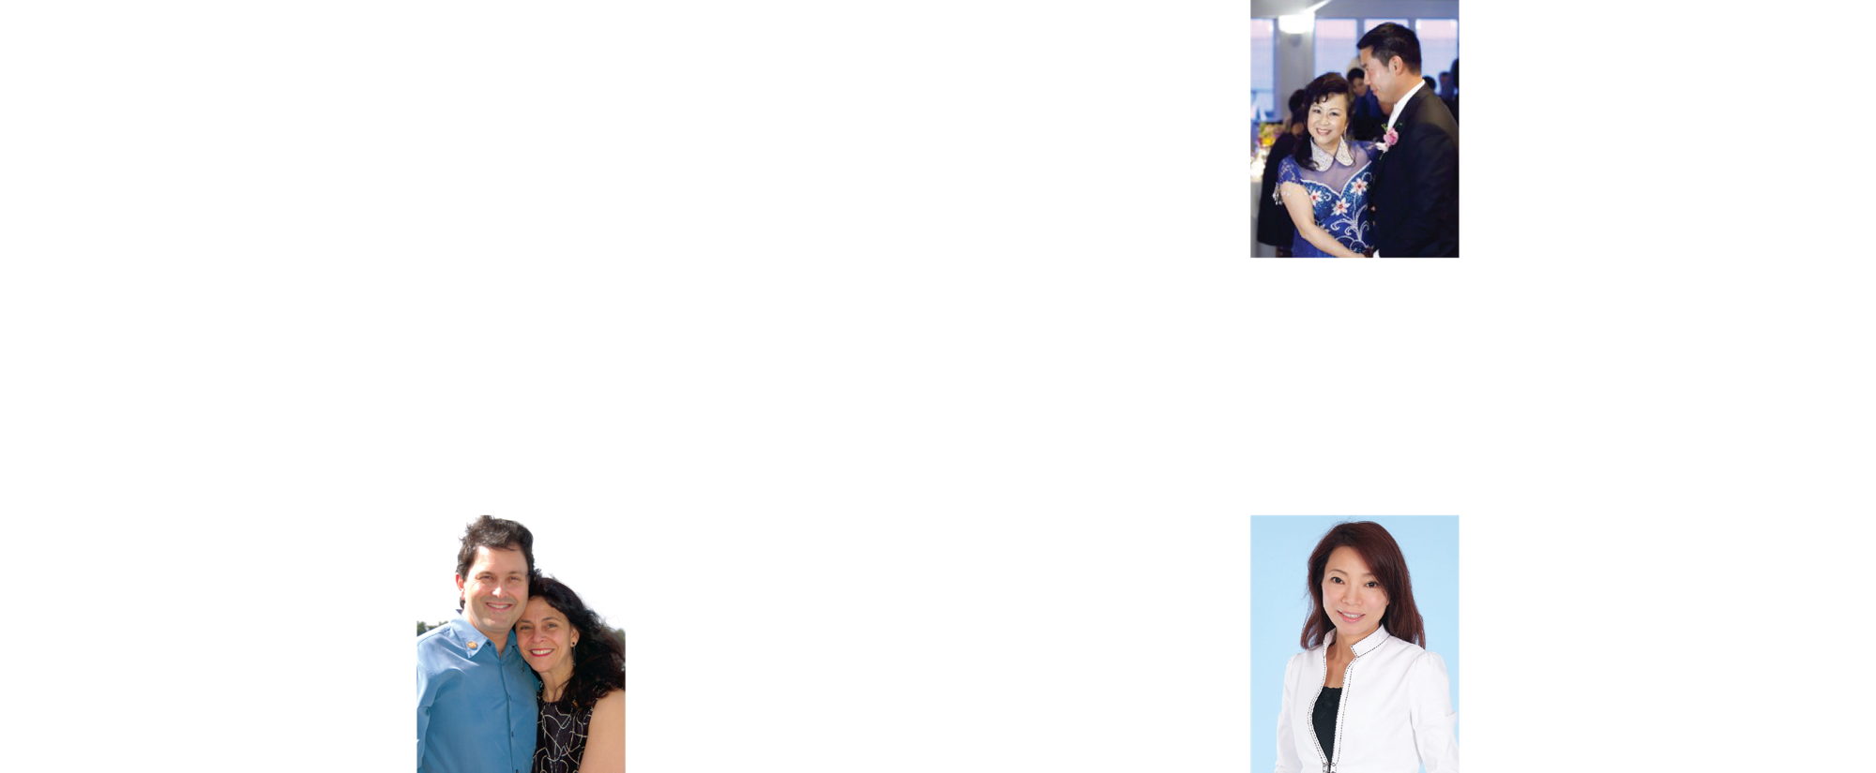
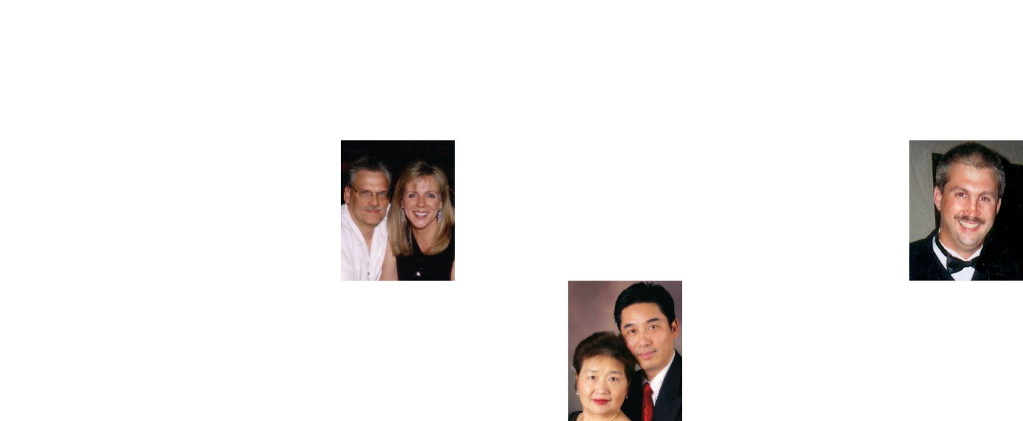
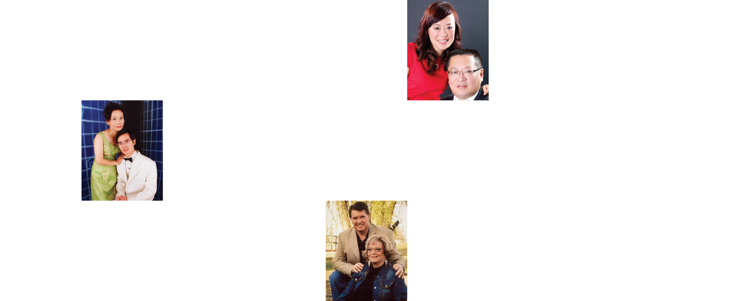
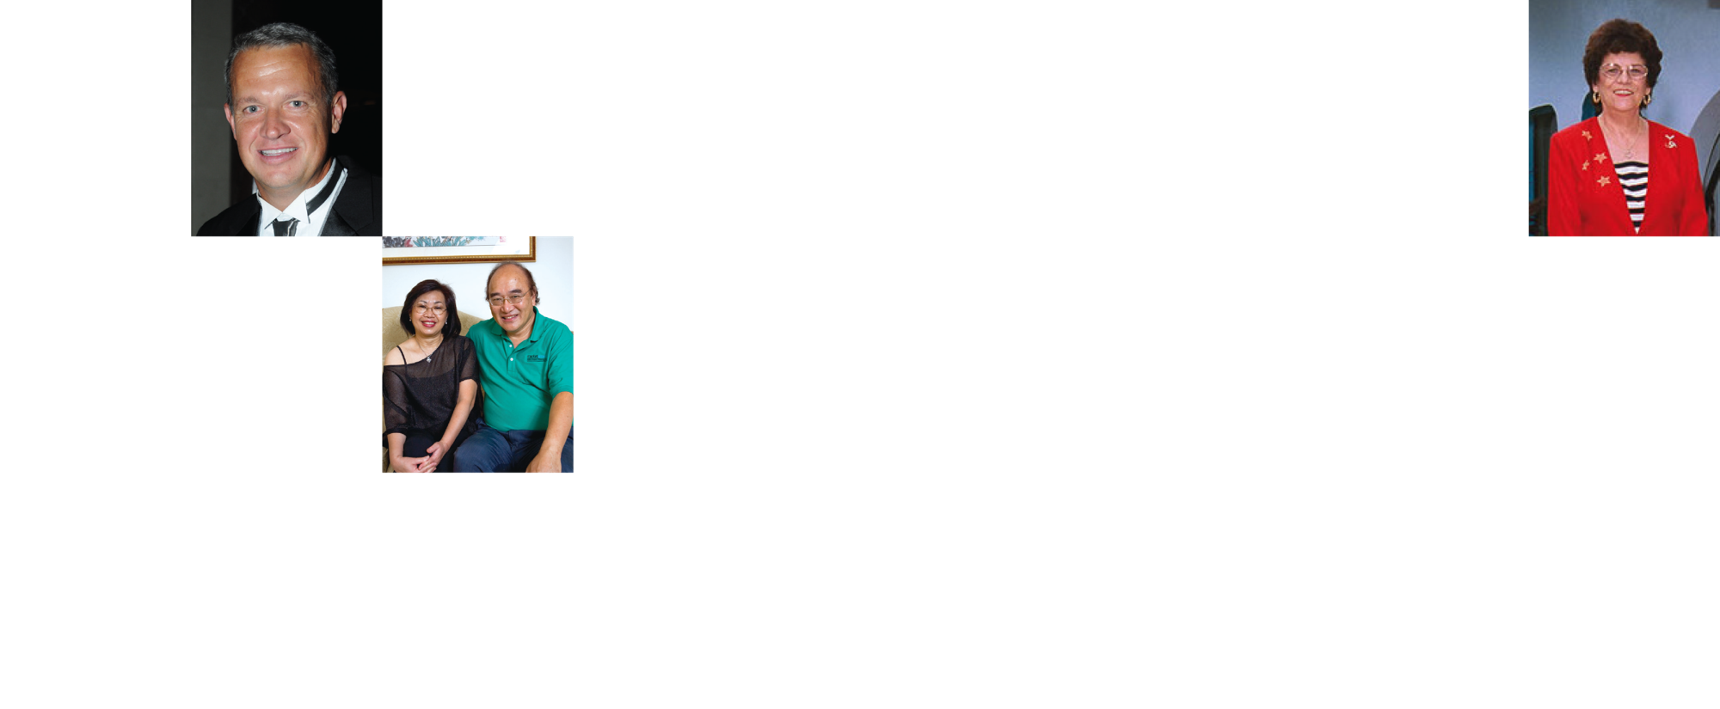
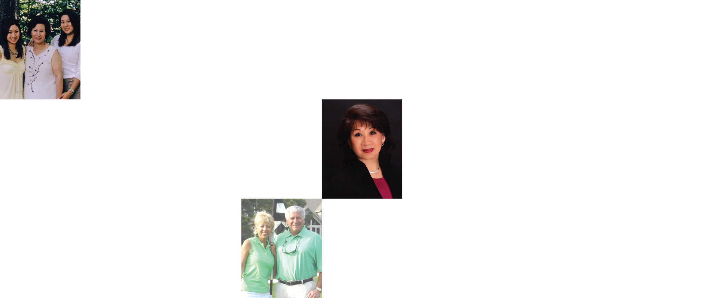
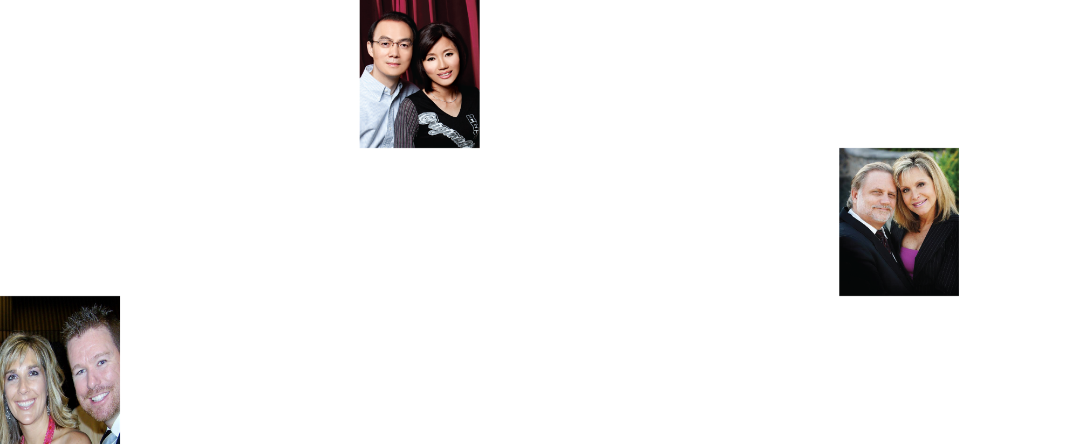
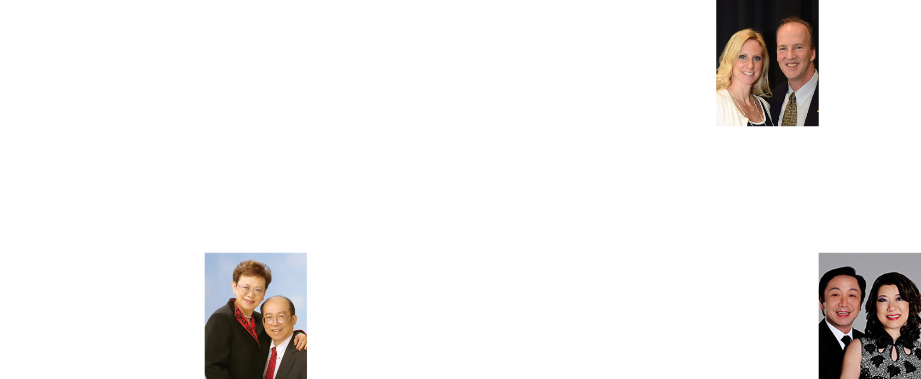
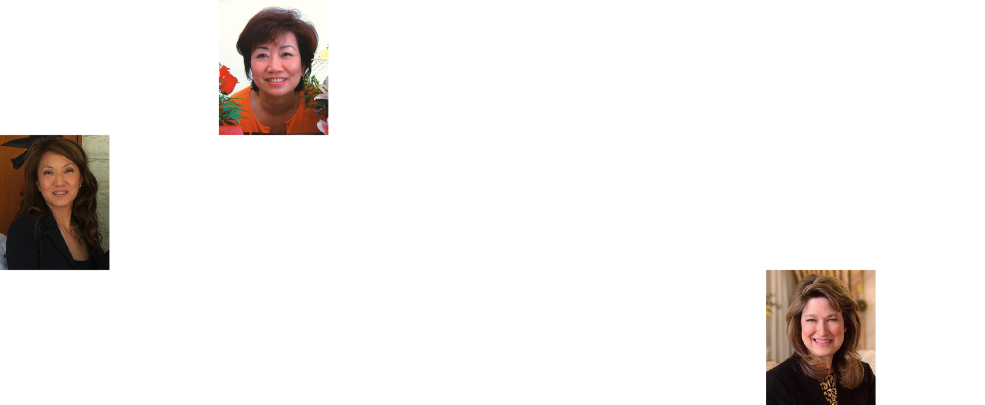
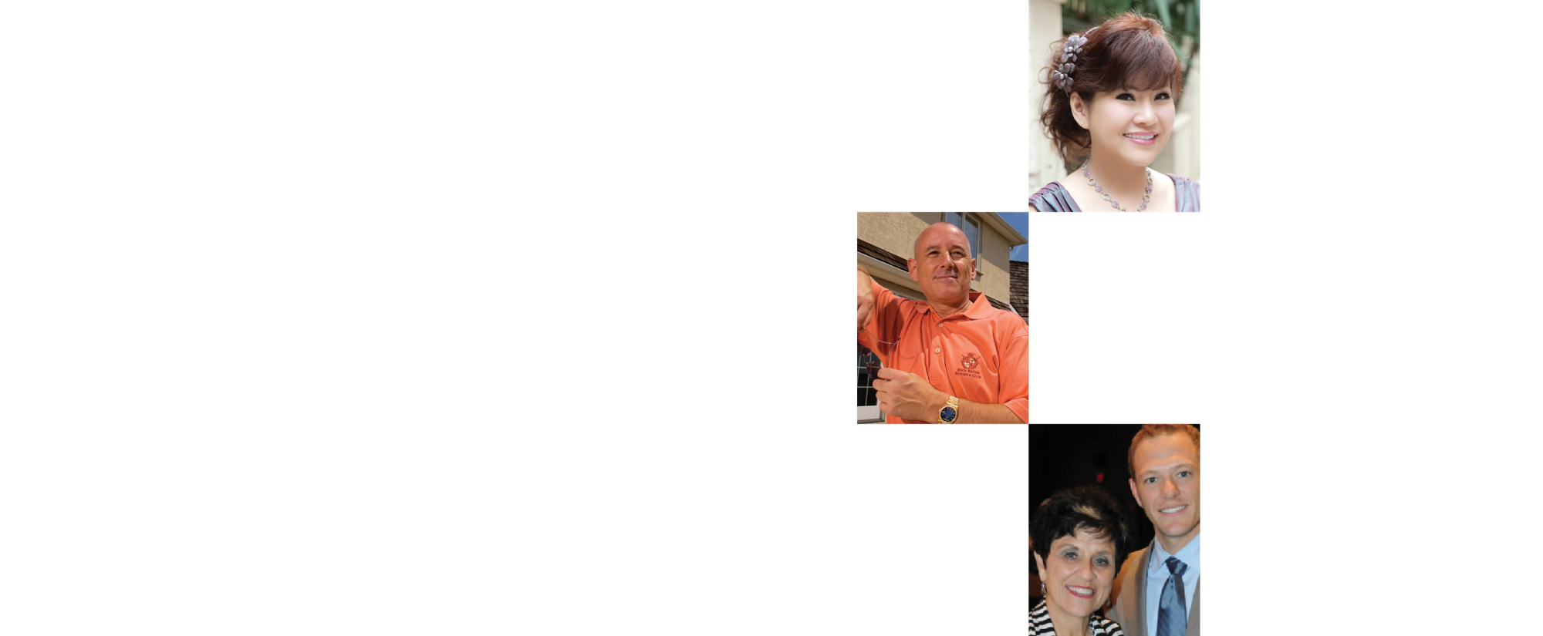
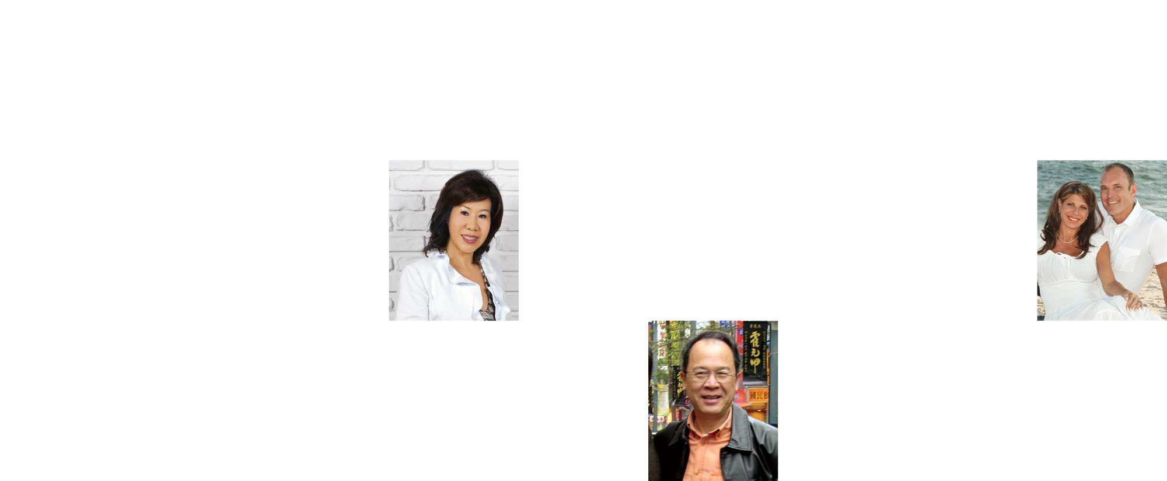
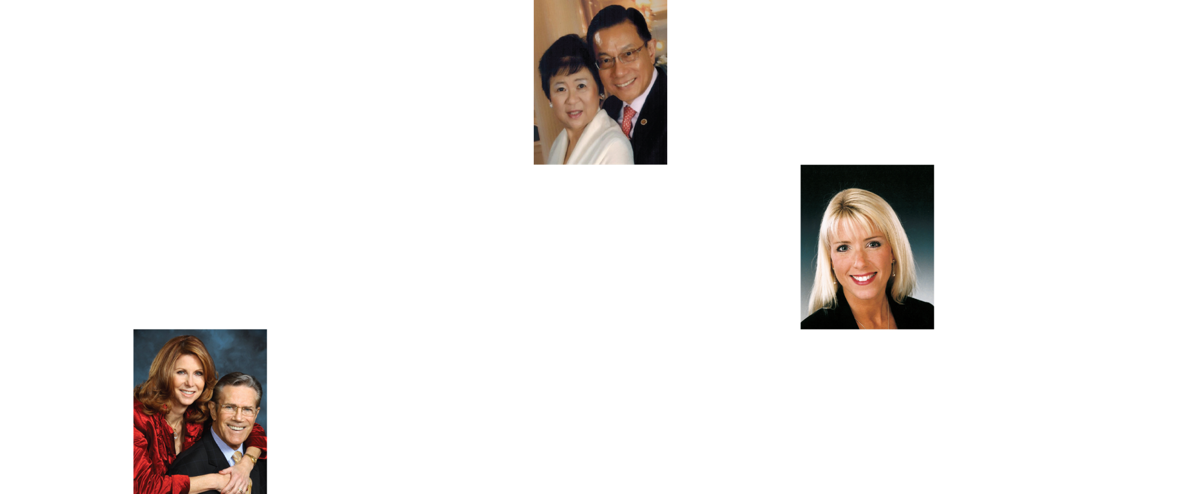
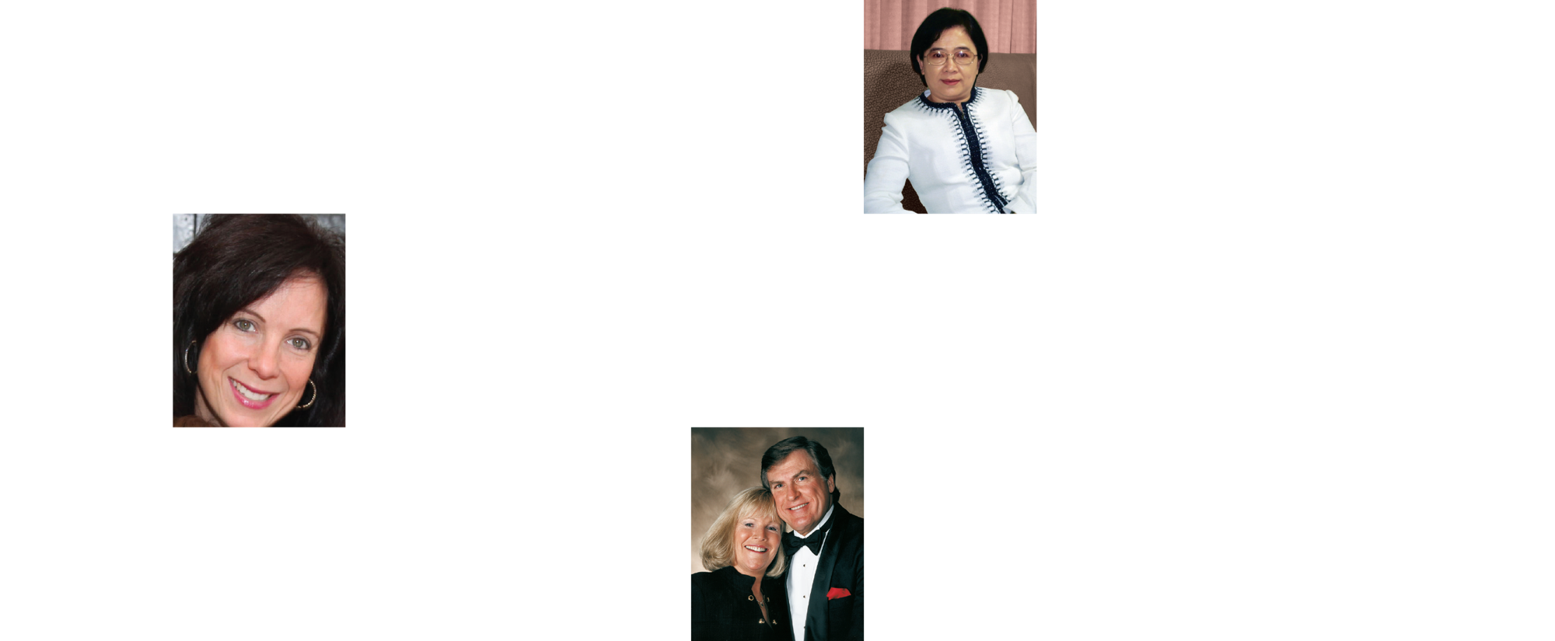
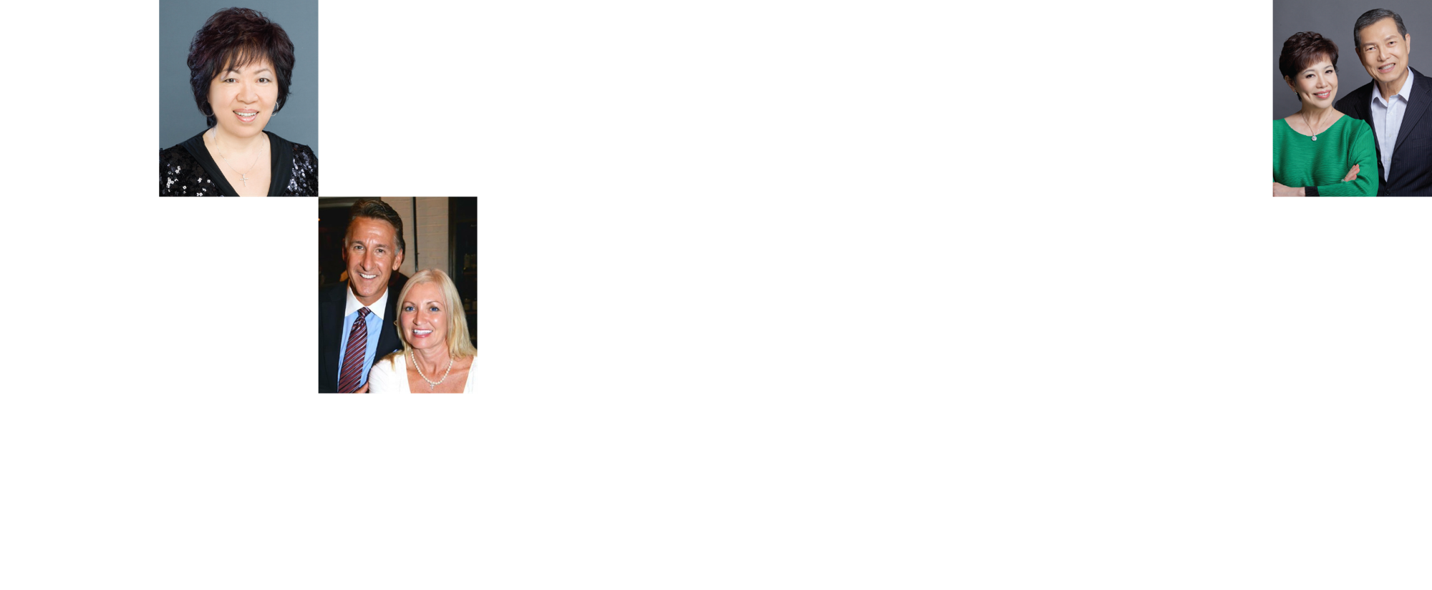
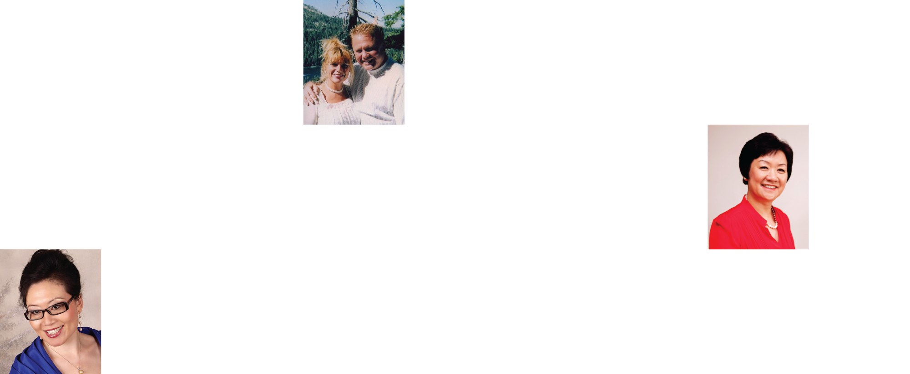
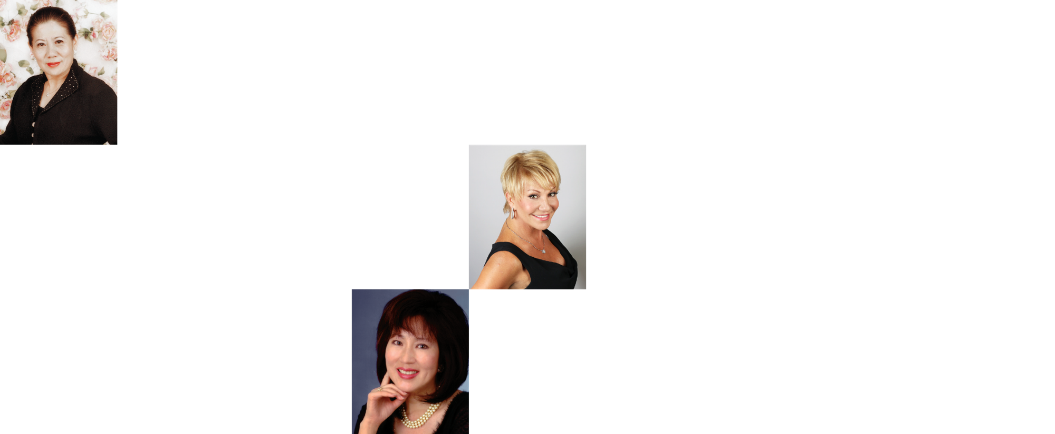
EARNED OVER ONE MILLION DOLLARS IN COMMISIONS
Market Singapore®| SHOP.COM™ is changing the way that people shop and changing the economic paradigm
so everyone can become financially independent by creating their own economy.

Slide 5
How to make the very first one million dollArs?

Slide 6
Your Options to Earn
A Significant Income
Work longer hours
Get a second job
Go back to school
Investments
Own your own business

Slide 7

Your Options to Earn
A Significant Income
  Traditional Business S$625,000 to purchase
  Start-Up Business S$125,000 to capitalise
  Franchise S$200,000/avg. to purchase
  Professional
  6 to 10 years Education
  @ S$125,000 to S$750,000

Slide 8
Time to wake up

Slide 9
Time talks
Retail: SABP
Recruit: MUFO
Duplicate: GMTSS

Slide 10
Pay the price, win the prize

